Slide 1
Computer Systems
Exercise Session 4

Slide 2
Exam question
vs
My email: ferraric@ethz.ch
https://hanslodge.com/clipart/8Txr4xdoc.htm
http://clipartmag.com/angel-cartoon-clipart

Slide 3
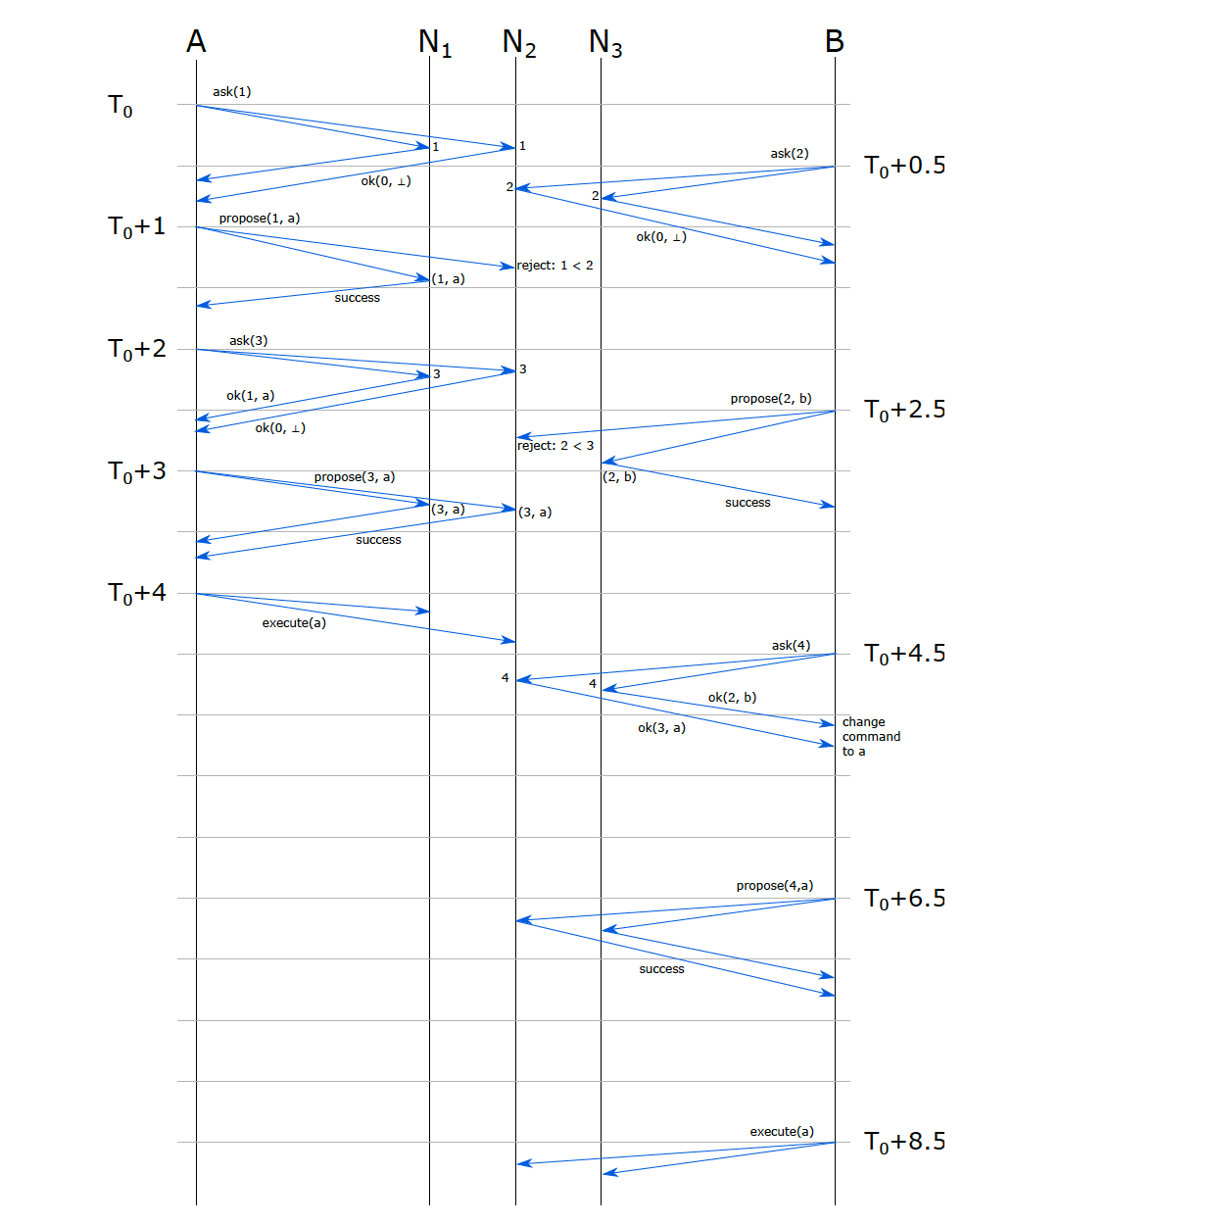
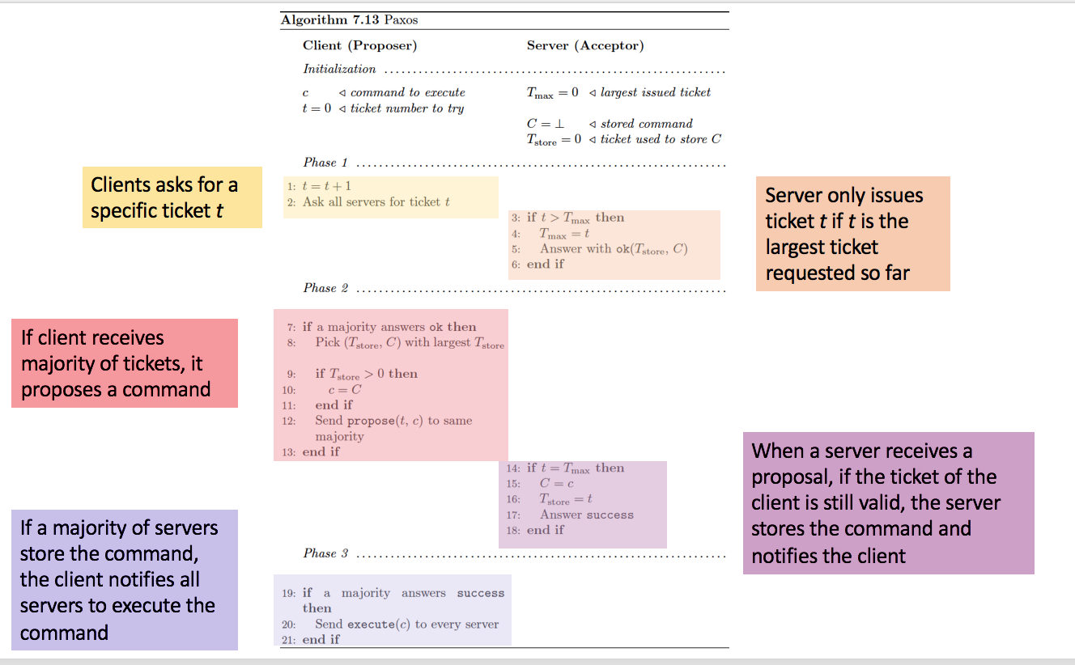
Last exercise
Exercise: 3 servers N1, N2, N3. Two clients A, B.
SuggestValue(N1, N2, a, 1, 1) on A at time T0,
suggestValue(N2, N3, b, 2, 2) on B at time T0 + 0.5sec

Slide 4
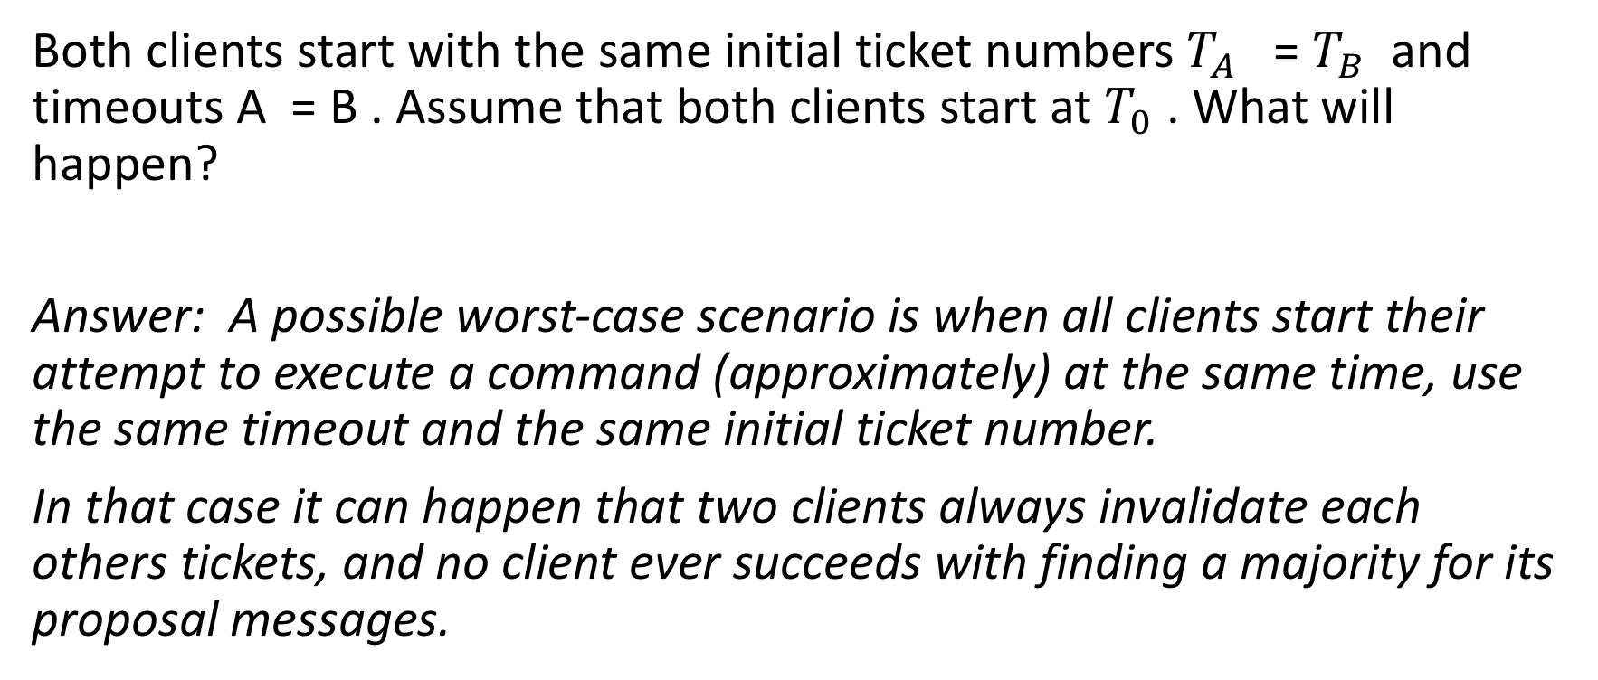
Last exercise
Both clients start with the same initial ticket numbers $T_{A}$ = $T_{B}$ and timeouts A = B . Assume that both clients start at $T_{0}$ . What will happen?
Answer: A possible worst-case scenario is when all clients start their attempt to execute a command (approximately) at the same time, use the same timeout and the same initial ticket number.
In that case it can happen that two clients always invalidate each others tickets, and no client ever succeeds with finding a majority for its proposal messages.

Slide 5
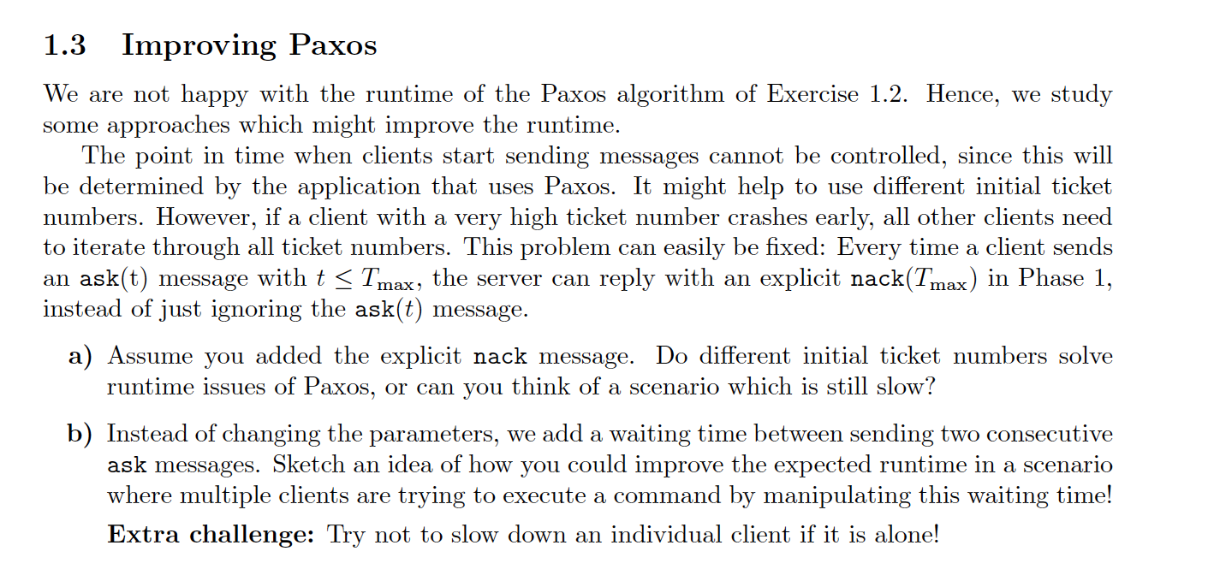
Last exercise
Answers:
a) No, it is not beneficial since same scenario can occur: two clients get nack(100) and then both at the
same time try 101 etc.
b) Exponential backoff

Slide 6
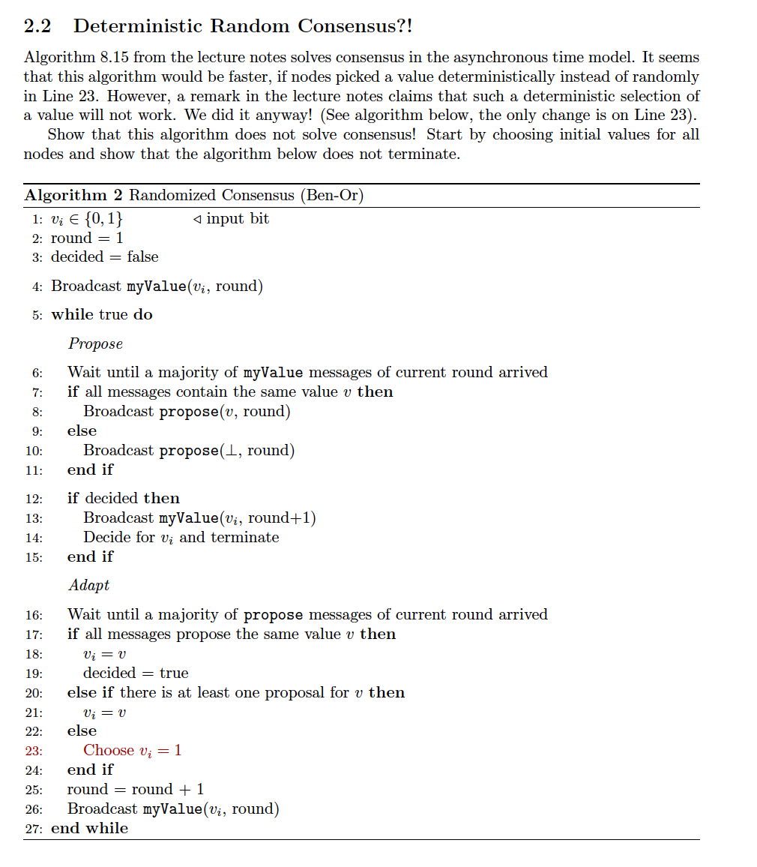
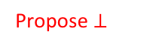
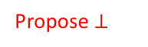

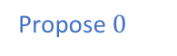
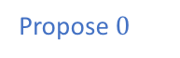
Last exercise
Propose $0$
Propose $⊥$
Propose $0$
Propose $⊥$
Propose $⊥$

Slide 7
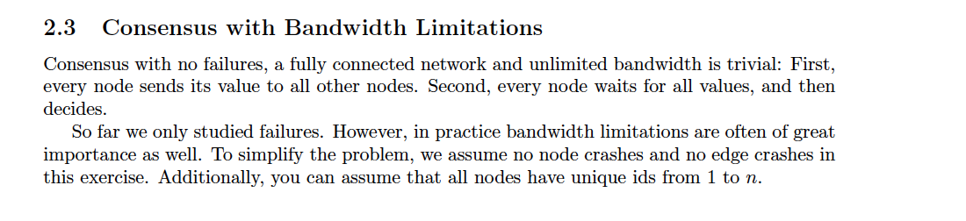
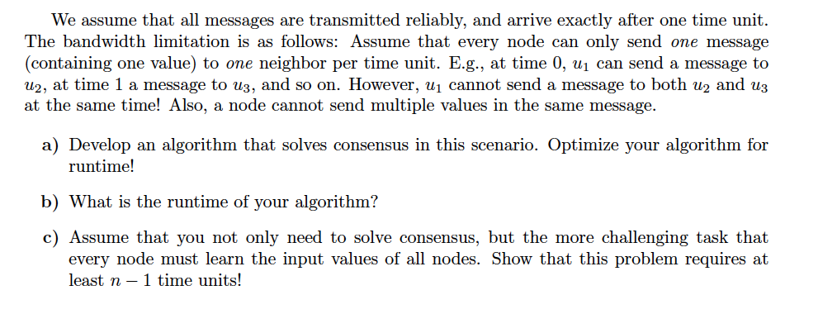
Last exercise

Slide 8
Last exercise

Slide 9
Last exercise

Slide 10
Last exercise

Slide 11
Last exercise

Slide 12
Last exercise

Slide 13
Last exercise
Answers:
b) log(n)
c) Each node needs to learn n-1 values,
so it needs to receive at least n-1 messages.
So in total there need to be n(n-1) messages
received. Because every received message
has been sent at some point, n(n-1) need to get sent
which requires n-1 rounds.

Slide 14
Scheduling
Deciding how to allocate a single resource among multiple clients.
In what order
How long

Slide 15
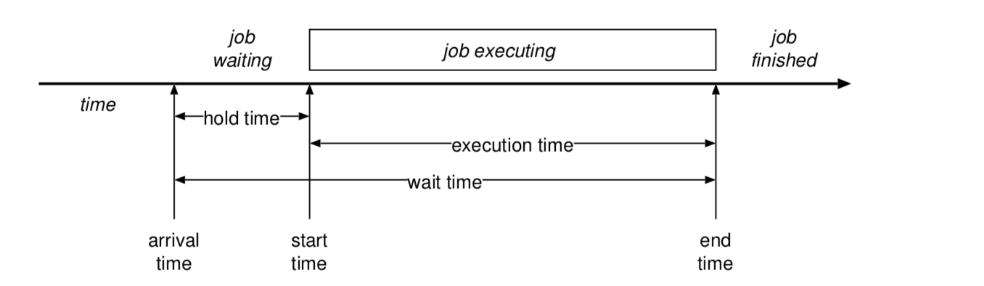
Scheduling Terminology
= turnaround time
Response time: worst case hold time (only used for interactive workloads)

Slide 16
Different kinds of workloads
Batch workload
“Run this job to completion and tell me when you’re done”
Main goals: throughput (jobs per hour), wait time, turnaround time, utilization
Interactive workloads
“Wait for external events and react before the user gets annoyed”
Main goals: Response time, proportionality
Soft realtime workloads
“This task must complete in less than 50ms” or “This program must get 10ms CPU every 50 ms”
Main goals: deadlines, guarantees, predictability
Hard realtime workloads
“Ensure the plane’s control surface moves correctly in response to the pilot’s actions”
Difficult, not covered

Slide 17
Preemptive vs non-preemptive
Preemptive:
Processes dispatched and descheduled without warning
Non-preemptive
Process explicitly has to give up the resource

Slide 18
When scheduling decisions are made
A running process blocks (or calls yield)
A blocked process unblocks
A running or waiting process terminates
An interrupt occurs (preemption)

Slide 19
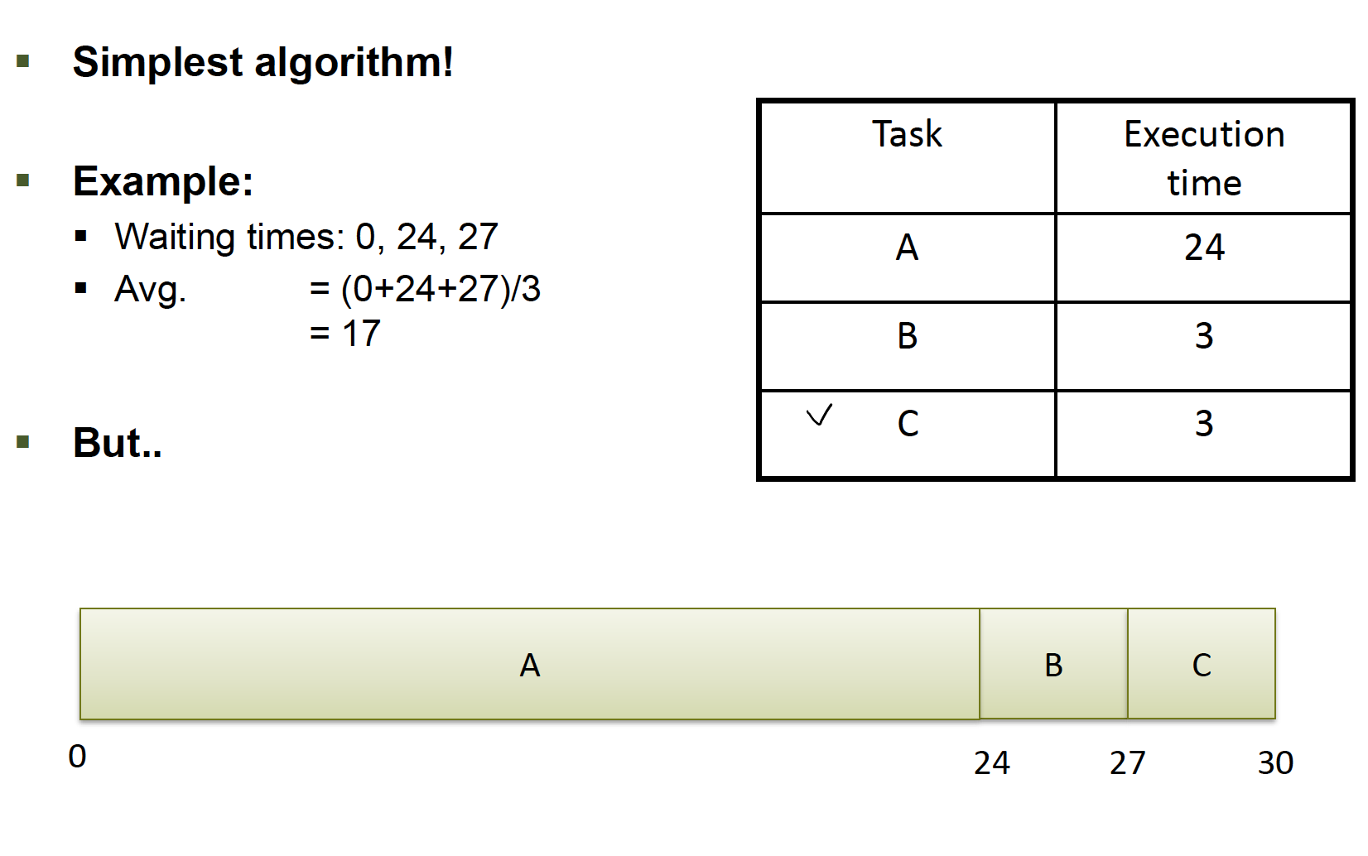
FIFO (Batch scheduling)

Slide 20
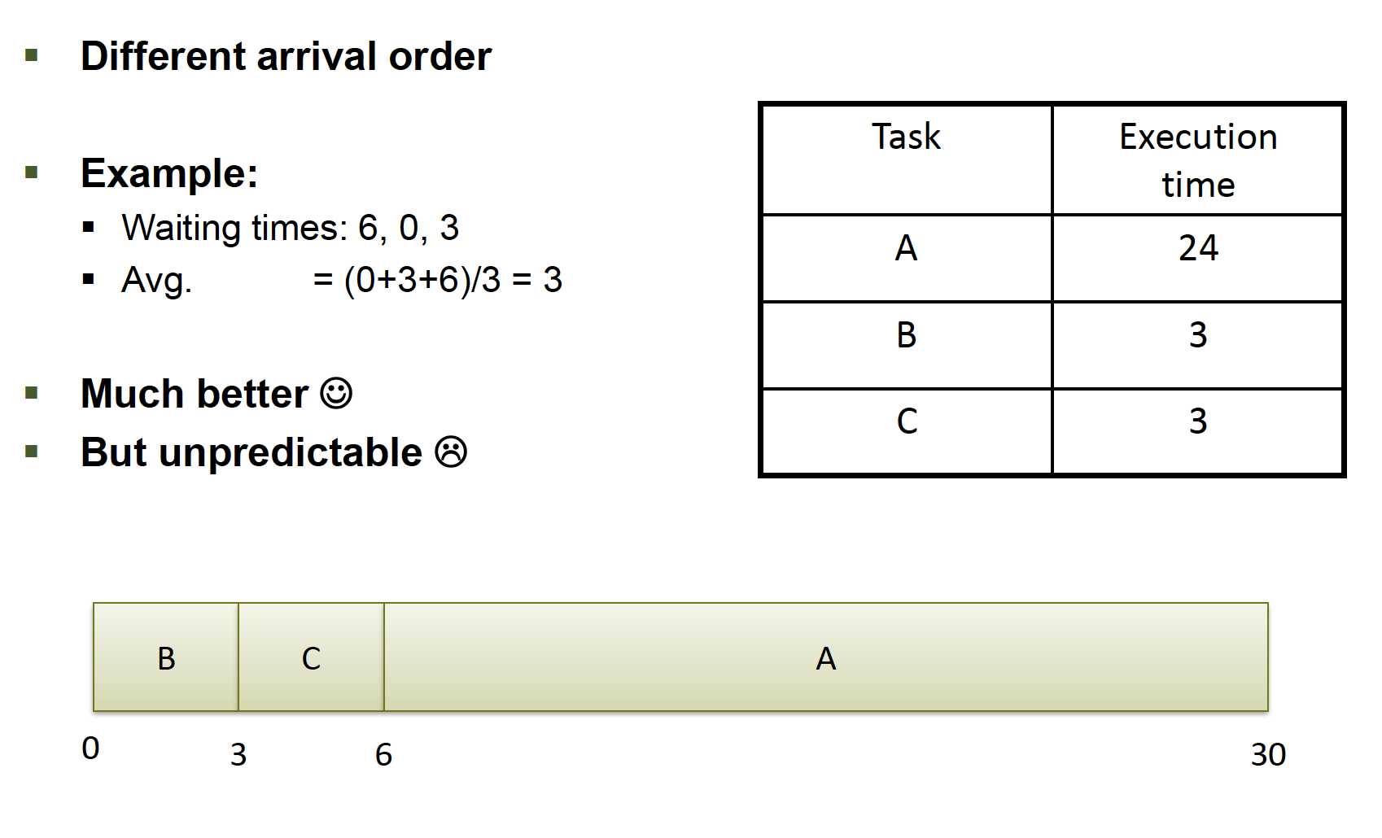
FIFO - Problem

Slide 21
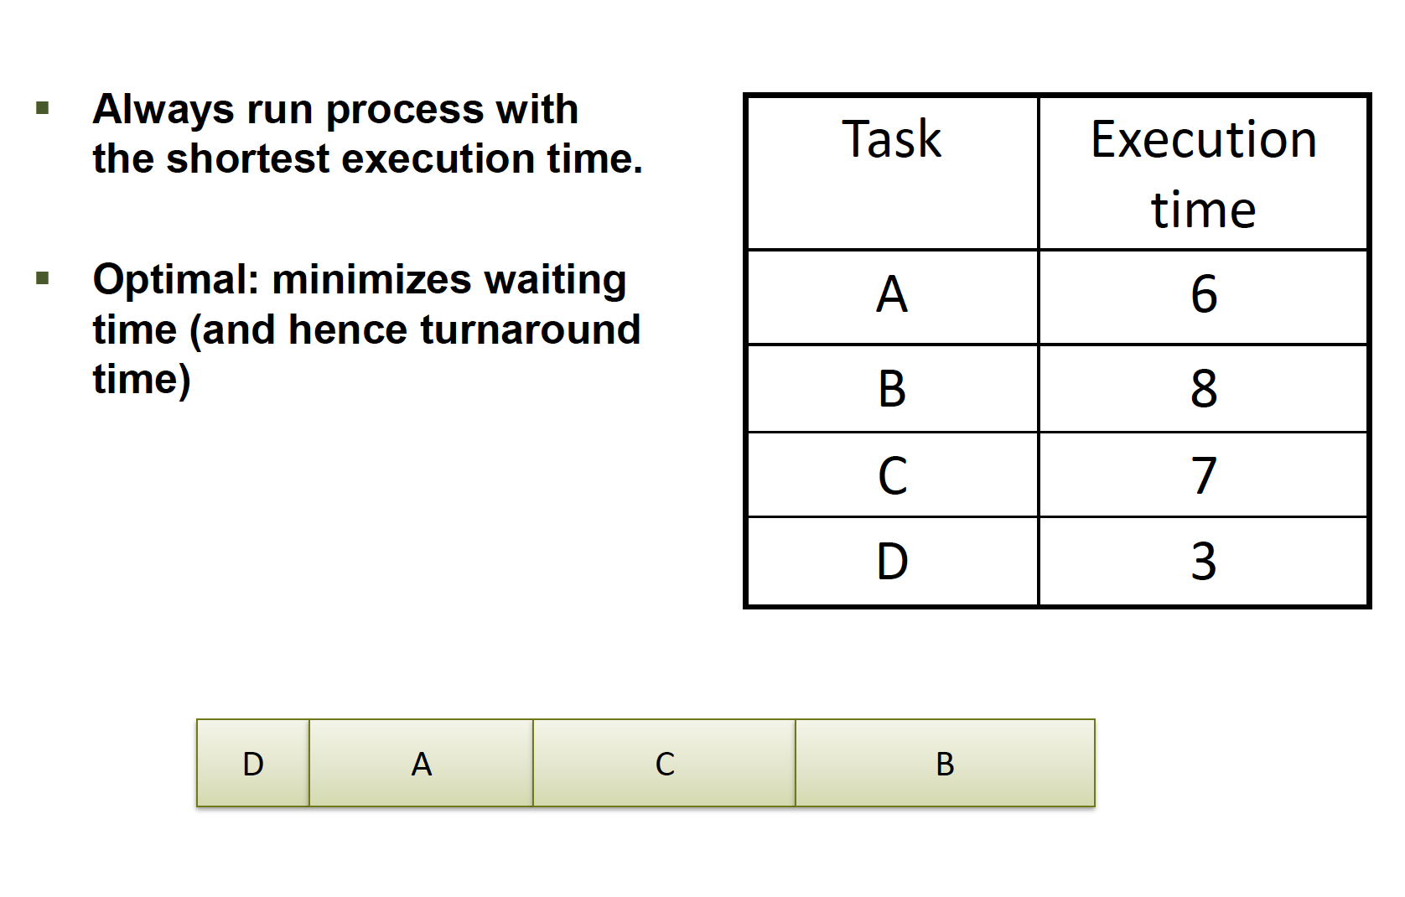
Shortest job first (Batch scheduling)
→ With preemption: shortest remaining time first

Slide 22
Round robin (interactive workloads)
Process | Execution time (ms)
A | 2
B | 3
C | 4
Maintains a queue of jobs and schedules them in order
Higher turnaround than shortest job first, but better response time (goal of interactive workloads)
 | 1 | 2 | 3 | 4 | 5 | 6 | 7 | 8 | 9
A
B
C

Slide 23
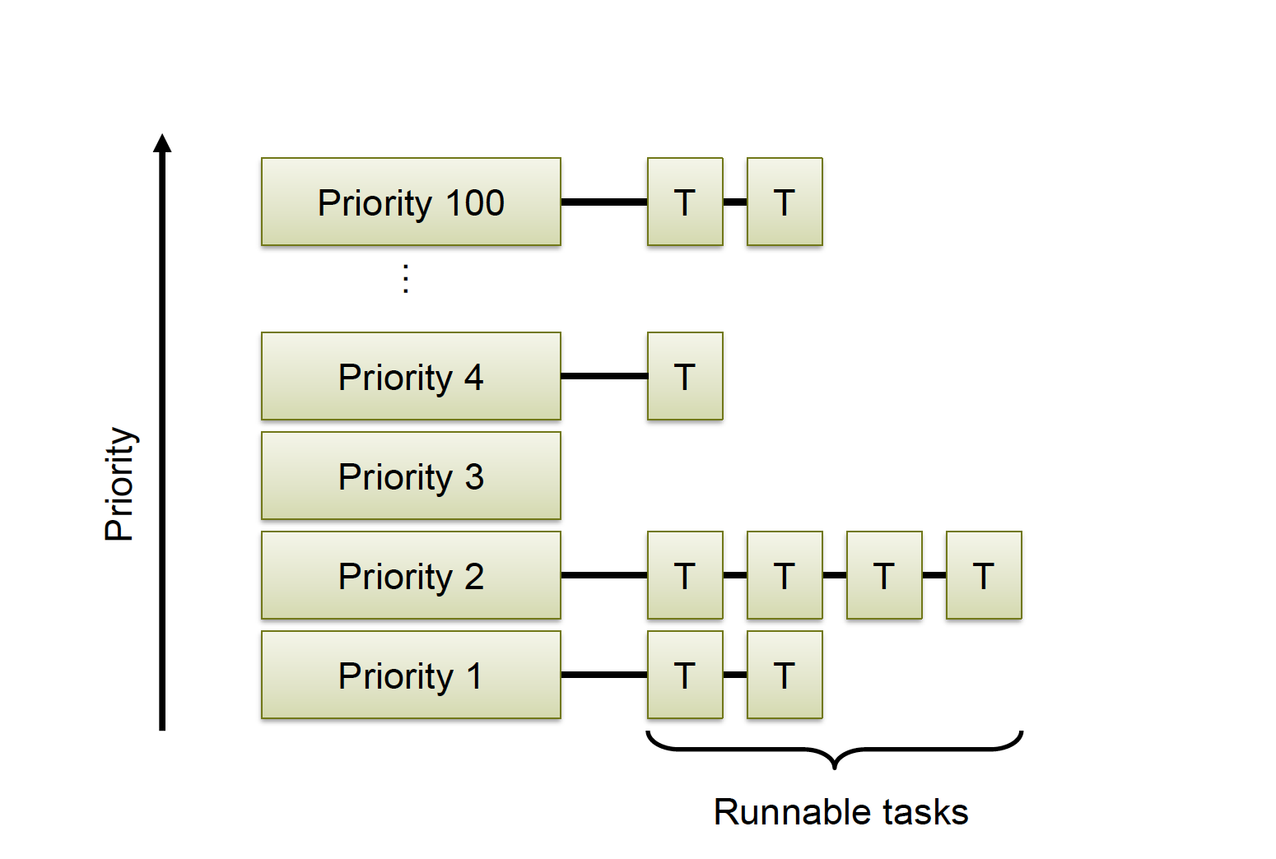
Priority Queues (interactive workloads)
Can schedule differently on different levels, eg. round robin and shortest job first

Slide 24
Priority Queues – Problem
Starvation– jobs with low priority never get scheduled
Solution: jobs gain priority with time, so called “ageing”
Reset original priority after being scheduled

Slide 25
Priority Inversion
Can not take Mutex → blocks and allows other T2 to run
T3
Preemption
Priority
T2
Takes Mutex
T1
Time

Slide 26
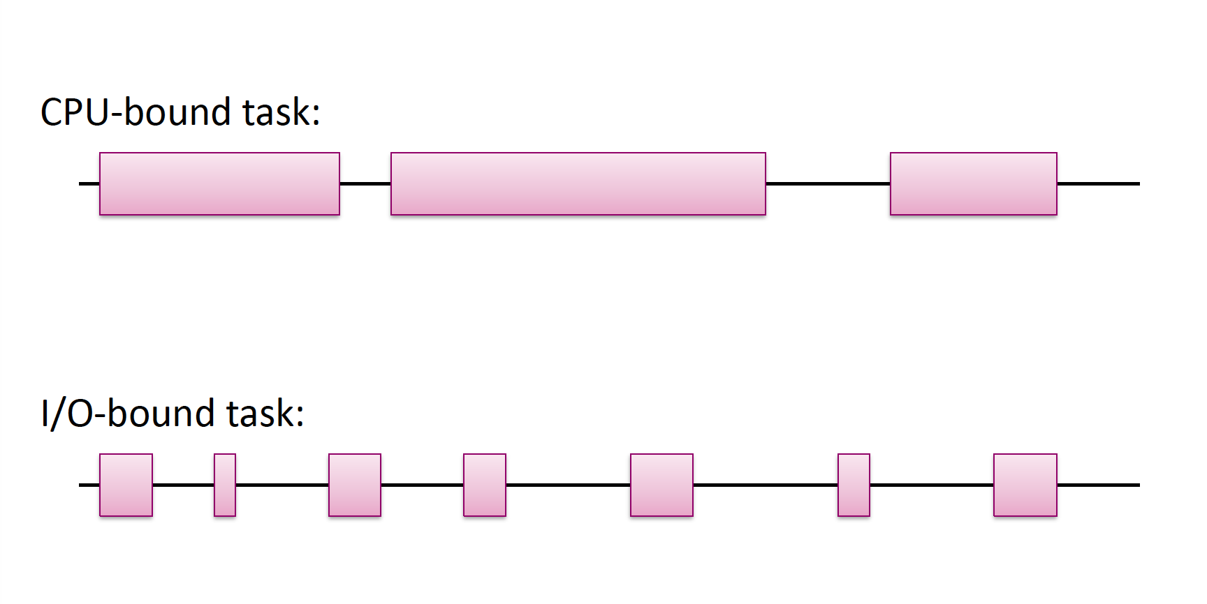
CPU and I/O bound tasks

Slide 27
Multilevel Feedback Queues (interactive workloads)
Same idea as priority queues
Idea: prioritize I/0 tasks
Solution: use priority queue and reduce priority of processes which use their entire quantum
I/0 bound processes tend to only use part of their quantum, so remain high priority

Slide 28
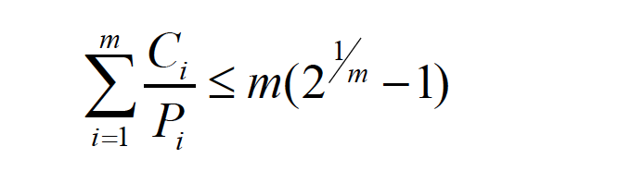
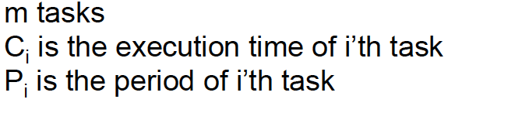
Rate monotonic scheduling (real time scheduling)
Schedule periodic tasks by always running task with shortest period first.
Will find schedule if:

Slide 29
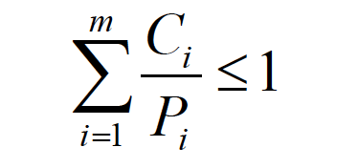
Earliest deadline first (real time scheduling)
Schedule tasks with earliest deadline first
Will find schedule if:
Notes:
Online in contrast to RMS which is offline

Slide 30
What is a device?
Specifically, to an OS programmer:
Piece of hardware visible from software
Occupies some location on a bus
Set of registers
Memory mapped or I/O space
Source of interrupts
May initiate Direct Memory Access transfers

Slide 31
Programmed I/O
Device
CPU
Programmed I/O
DMA
Memory
Programmed I/O

Slide 32
Direct Memory Access (DMA)
Avoid programmed I/O for lots of data (requires CPU)
Device needs to be able to do DMA (DMA controller)
Generally built-in these days
Bypasses CPU to transfer data directly between I/O device and memory
Doesn’t take up CPU time
Only one interrupt per transfer

Slide 33
I/O Protection
DMA operations can be dangerous to normal system operations because they directly access memory!
⇒ need IOMMU (I/O Memory Management Unit) to ensure that devices only access memory that they’re supposed to access
Need to invalidate cache before transfer

Slide 34
Evolution of device I/O
Programmed I/O with polling.
Polling is too slow (CPU cycles, response latency)
⇒ Interrupts notify CPU device needs attention
Programmed I/O with interrupts.
CPU spends too much time copying data
⇒ DMA allows CPU and device to operate in parallel
DMA

